Slide 1
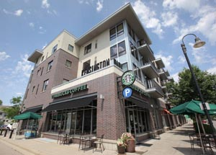
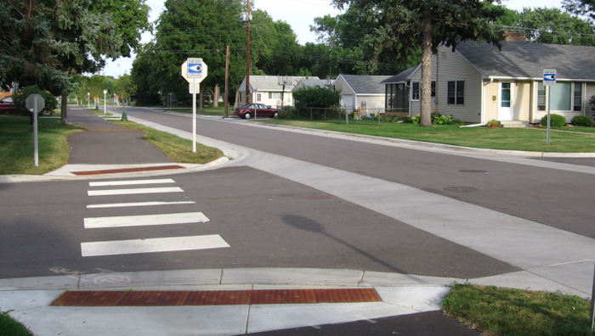
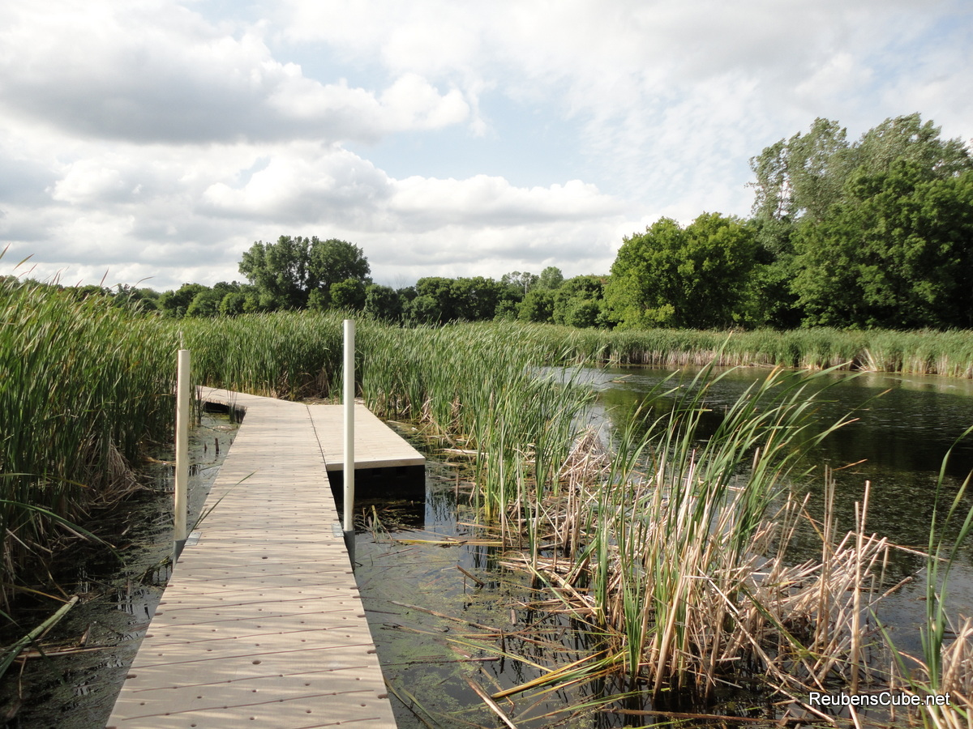
City of Richfield Comprehensive Plan Update
Advisory Committee Meeting Monday, February 12, 2018

Slide 2
Welcome
Tonight’s Talking Points
Introductions (5 minutes)
Project Management Changes (5 minutes)
Recap to Comprehensive Planning (5 minutes)
Highlight Changes by Plan Element (60 Minutes)
Group Discussion
Next Steps (5 minutes)

Slide 3
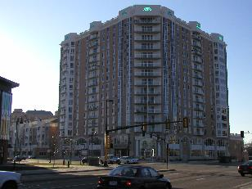
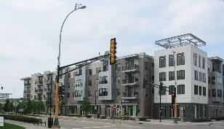
Comprehensive planning 101
Comprehensive Plans Provide:
Vision Statements and Goals
Policy Direction
Guides Growth
Twenty Year Time Horizon
Prepares for Implementation

Slide 4
Comprehensive planning 101
Minnesota State Statue
Seven County Metro Cities and Counties are required to update their plans every 10 years.
Facilitated by the Metropolitan Council
Updates need to align with regional polices (2040 Thrive MSP)

Slide 5
Plan Element Requirements

Slide 6
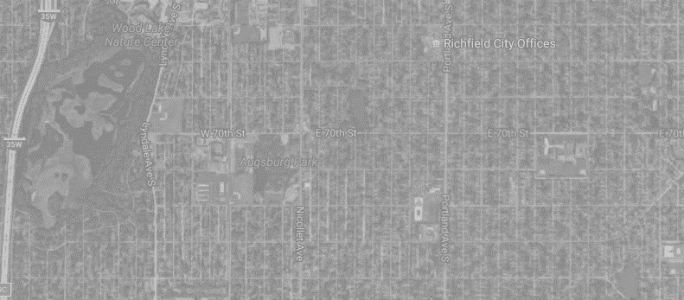
Plan Element Requirements
2008 Forecasts |  |  | Year | Current Forecasts
Population | Households | Jobs |  | Population | Households | Jobs
37,700 | 16,500 | 17,100 | 2010 | 35,228 | 14,818 | 15,604
41,300 | 18,000 | 17,600 | 2020 | 37,100 | 15,900 | 16,600
45,000 | 19,500 | 18,100 | 2030 | 37,300 | 16,300 | 17,100
- | - | - | 2040 | 37,700 | 16,700 | 17,500

Slide 7
Comprehensive Plan Chapters
Chapter 1: Introduction
Chapter 2: Community Direction
Chapter 3: Demographics, Social & Economic Trends
Chapter 4: Goals & Policies
Chapter 5: Land Use
Chapter 6: Housing
Chapter 7: Transportation
Chapter 8: Parks
Chapter 9: Utilities & Water
Chapter 10: Implementation
Tonight's
Focus

Slide 8
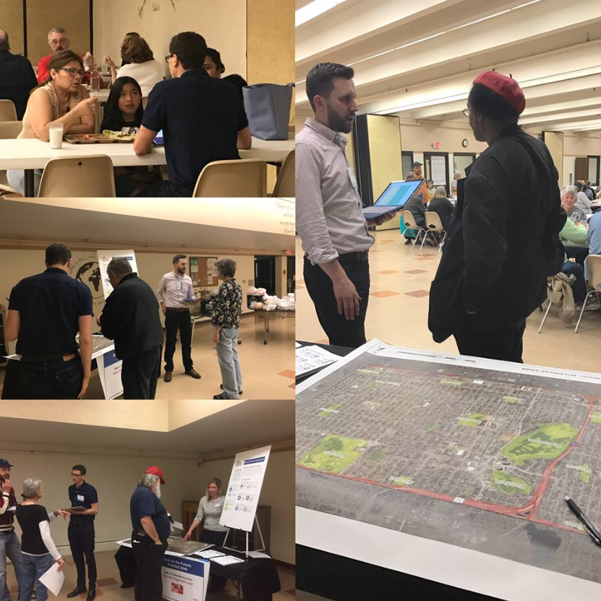
Chapter 2: Community Directions
Key Changes:
Recognizes Public Input (Key Themes)
Urban vs. Suburban
Higher Density vs. Lower Density
Affordably Housing Need vs. Too Much Affordable Housing
Redevelopment
Valued Characteristics
Valued Amenities

Slide 9
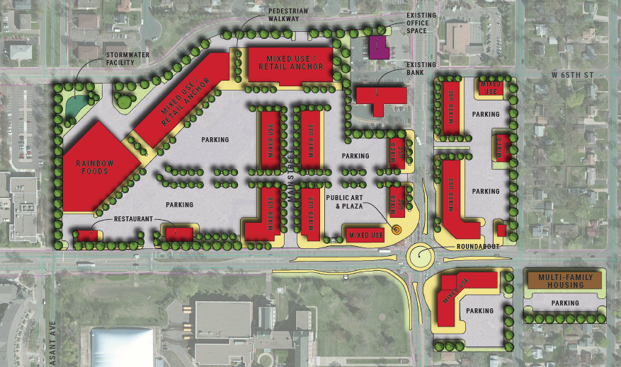
Chapter 2: Community Directions
Key Changes:
Provides guidance for 66th Street and Nicollet Avenue

Slide 10
Chapter 4: Goals and Policies
Richfield, the “Urban Hometown”
“The Urban Hometown, is a community that reflects the characteristics of living in a close-knit community, while surrounded by the amenities and resources of a broader metropolitan area. The urban hometown feeling is rooted in the personal connections cultivated within our neighborhoods, parks, schools and streets. These connections are reinforced by quality housing, local commercial centers, recreational opportunities, and the cultural diversity found within our city. Our proximity to the Twin Cities only serves to expand the opportunities available to our residents, providing the best of both small town living and urban life. Our goal is to embrace these characteristics, and take steps to maintain and enhance the culture and community that makes us an urban hometown.”
Key Changes:
Establishes a Vision
What is an Urban Hometown?
Recognizes Social Equity

Slide 11
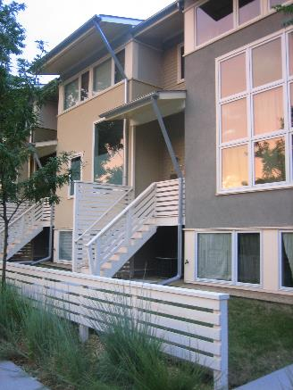
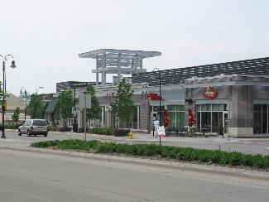
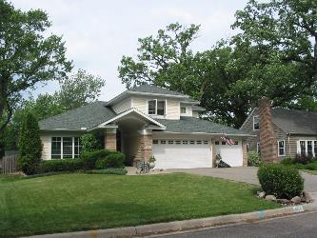
Chapter 5: Land Use Chapter 6: Housing
Key Changes:
Modified the Future Land Use Categories
Removed I-494 Corridor Plan references
Provided the Required Density Calculations
Focused on Redevelopment Areas
Provided the Required Affordable Housing Calculations

Slide 12
Chapter 5: Land Use
2030 Comprehensive Plan | 2040 Comprehensive Plan
Low Density Residential (LDR) | Low Density Residential (LDR)
Medium Density Residential (MDR) | Medium Density Residential (MDR)
Medium-High Density Residential (MHD) | Removed
High Density Residential (HDR) | High Density Residential (HDR)
High Density Residential/Office | Removed
Neighborhood Commercial (NC) | Neighborhood Commercial (NC)
Community Commercial (CC) | Community Commercial (CC)
Community Commercial/Office (CCO) | Removed
Regional Commercial (RC) | Regional Commercial (RC)
Regional Commercial/Office (RCO) | Removed
Mixed Use | Mixed Use
Office | Removed

Slide 13
Chapter 5: Land Use
2040 Land Use Plan | Min | Max | Sq. Ft. | Percent Residential | Percent Commercial/ Office
Low Density Residential (LDR) | 1 | 6 | - | 100% | 0%
Medium Density Residential (MDR) | 7 | 24 | - | 100% | 0%
High Density Residential (HDR) | 25 | 50 | - | 100% | 0%
Neighborhood Commercial (NC) | - | - | 5,000 sf (max) | 0% | 100%
Community Commercial (CC) | - | - | 150,000 sf (max) | 0% | 100%
Regional Commercial (RC) | - | - | 150,000 + sf | 0% | 100%
Mixed Use
Lyndale Avenue & 66th Street | 50 | 75 | TBD | 50% | 50%
Penn Avenue Corridor | 25 | 50 | TBD | 60% | 40%
Cedar Avenue Corridor | 25 | 50 | TBD | 40% | 60%
I-494 Corridor | 50 | 100 | TBD | 30% | 70%

Slide 14
Chapter 5: Land Use
Redevelopment Focused
Land Use | Total Acres | Percent of Acres Guided for Residential | Total Acres Allocated for Residential | Min Units Per Acre | Total Units
LDR (Infill) | 3.09 | 100% | 3.09 | 1 | 3
MDR | 11.00 | 100% | 11.00 | 7 | 77
HDR | 21.66 | 100% | 21.66 | 25 | 541
Mixed Use (Redevelopment Areas)
Lyndale/66th | 50.72 | 50% | 25.36 | 50 | 1,268
Penn Ave | 34.12 | 60% | 20.47 | 25 | 511
Cedar | 26.89 | 40% | 10.75 | 25 | 268
I-494 | 2.44 | 30% | 0.73 | 50 | 36
Total: | 149.93 | - | 93.08 | - | 2,704
Units Per Acre: |  |  |  |  | 29.05
Required Density Goal: 20 units per acre

Slide 15
Chapter 6: Housing
Document Affordable Housing Goals Set by the Metropolitan Council
Redevelopment Area | Acres (Net) | Min. Percent Residential | Total Acres Allocated for Residential | Min. Units/Acre | Units
HDR | 21.66 | 100% | 21.66 | 25.00 | 541
Mixed Use: Lyndale/66th | 50.72 | 50% | 25.36 | 50.00 | 1,268
Mixed Use: Penn Ave. Corridor | 34.12 | 60% | 20.47 | 25.00 | 511
Mixed Use: Cedar Ave. Corridor | 26.89 | 40% | 10.75 | 25.00 | 268
Mixed Use: I-494 Corridor | 2.44 | 30% | 0.73 | 50.00 | 36
Total | 135.83 | - | 78.97 | - | 2,624
Required Affordable Housing Goal: 121 units per acre

Slide 16
Chapter 7: Transportation
Key Changes
Multimodal Focused
Stronger Emphasis on Peds, Bikes and Transit
Incorporates Past Planning Efforts:
Bike Master Plan
Pedestrian Master Plan
Complete Streets Policy
Guiding Principles
Pedestrians/Bicyclists
Transit
Cars
2040 Plan

Slide 18
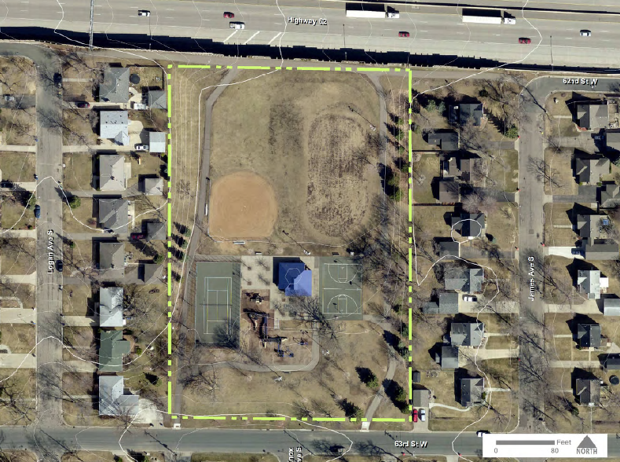
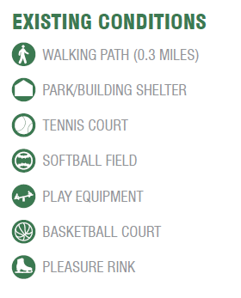
Chapter 8: Parks
Key Changes
Updates to the 10 Year Parks Master Plan
Inventory of all parks
Recommendations for each park
Planning Level Cost Estimates
Specific Recommendations:
Dog Park
Soccer Fields
Woodlake Nature Center Investments
Asset Management

Slide 19
Next Steps
Feb.
Finalize Chapters
Production
March
Advisory Committee Review (email)
Final Edits
April
Sept
Start 6 Month Mandatory Review
Open House
Close 6 Month Mandatory Review
Public Hearing
Plan Adoption
Work session with Planning Commission and City Council
What’s
Next?

Slide 20
Thank You
Thank you for your time and commitment to Richfield.

Slide 21
Questions & Discussion
Advisory Committee Meeting Monday, February 12, 2018

